Slide 1

The Plant Kingdom Vegetative root growth

Slide 2
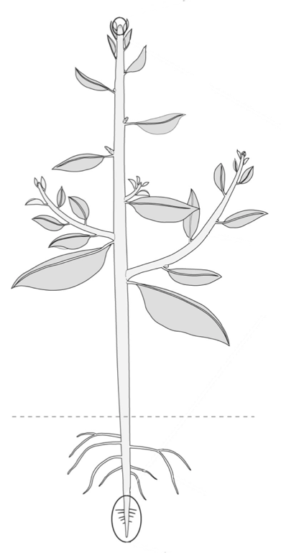
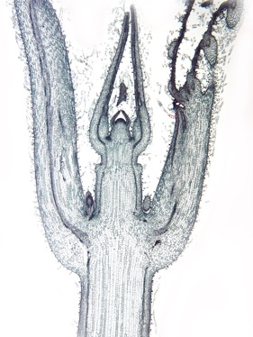
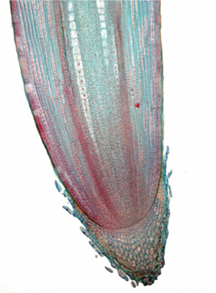
How plants grow
shoot apex
axillary bud
root apex

Slide 3
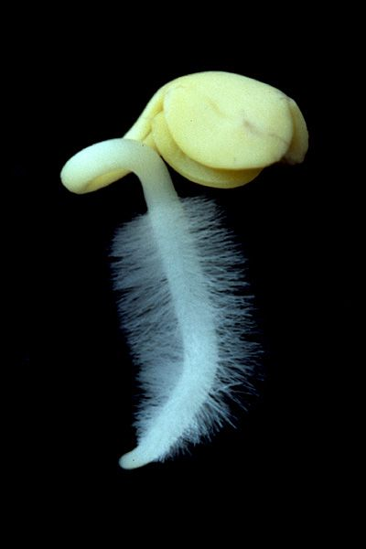
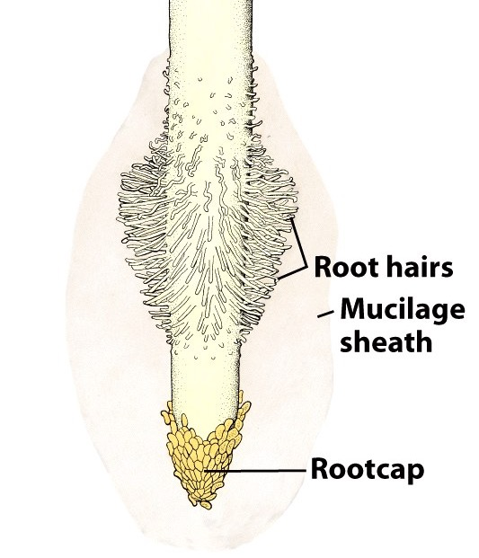
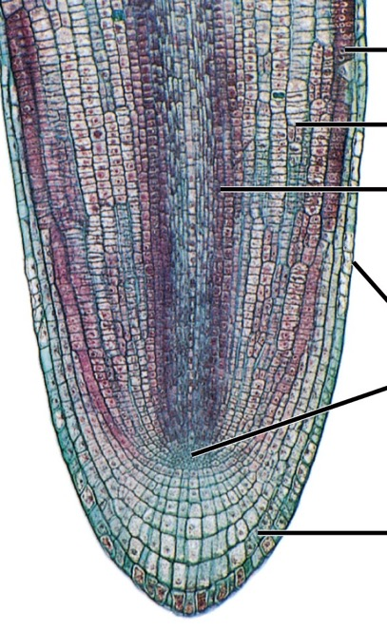
Root tip anatomy

Slide 4
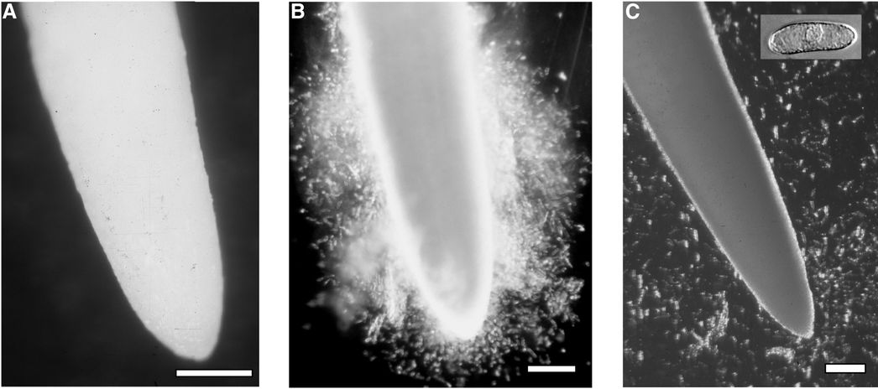
Border cells
Wen et al., 2017
Root tip in humid air
… then immersed in water
… and shaken a bit

Slide 5
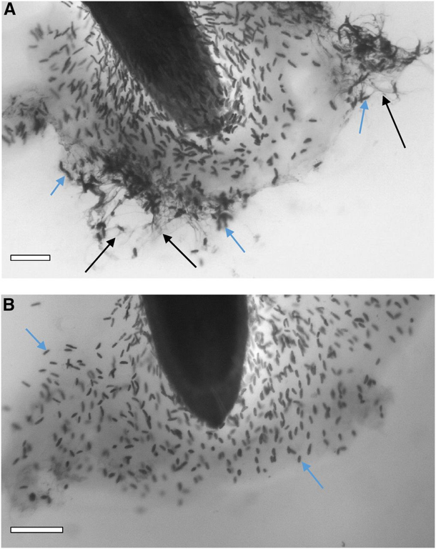
Border cells
Border cell
DNA
Wen et al., 2017
Root tip in humid air
… then immersed in water
… and shaken a bit

Slide 6
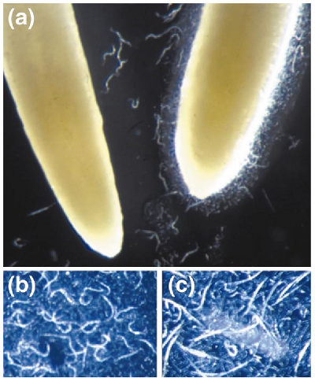
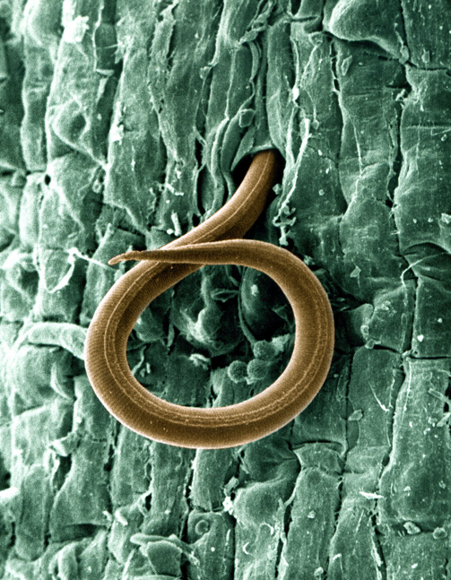
Border cell defense
Hawes et al., 2000

Slide 7
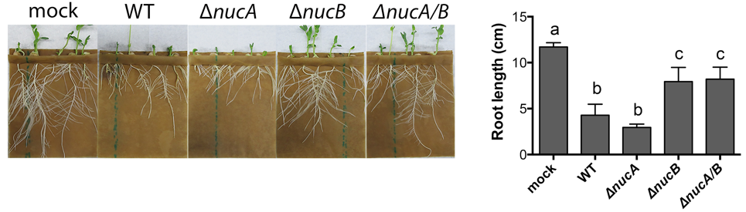
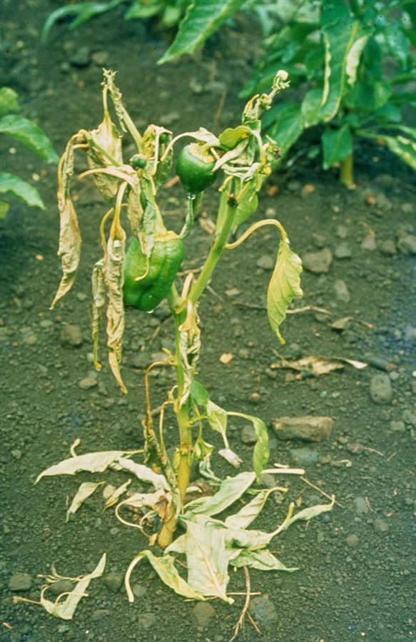
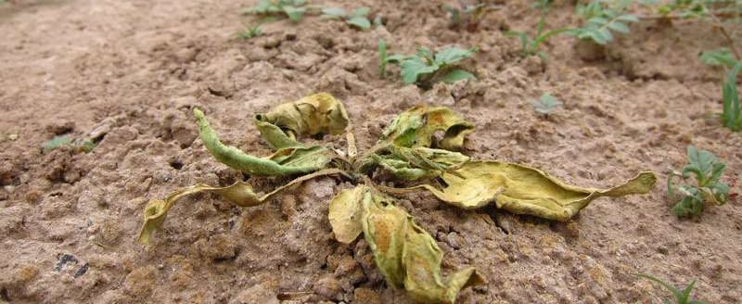
Outsmarting the border cells
Tran et al., 2016
(no bacteria)
(with bacteria)
(with bacteria that lack one or more nuclease digestive genes)

Slide 8
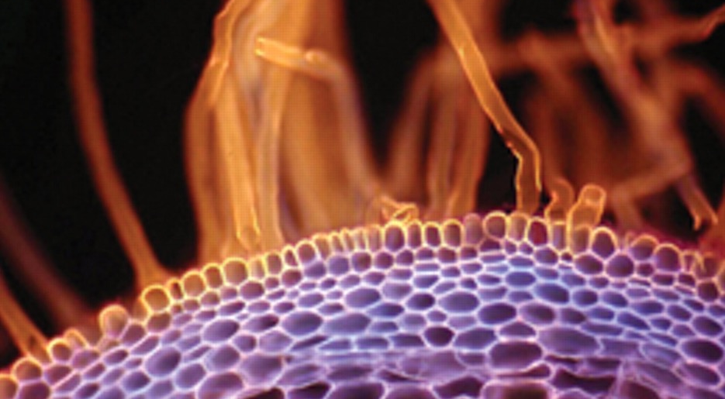
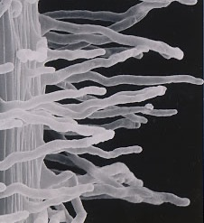
Root hairs
Outgrowths of epidermal cells (advantage?)
Short-lived, produced early in root development

Slide 9
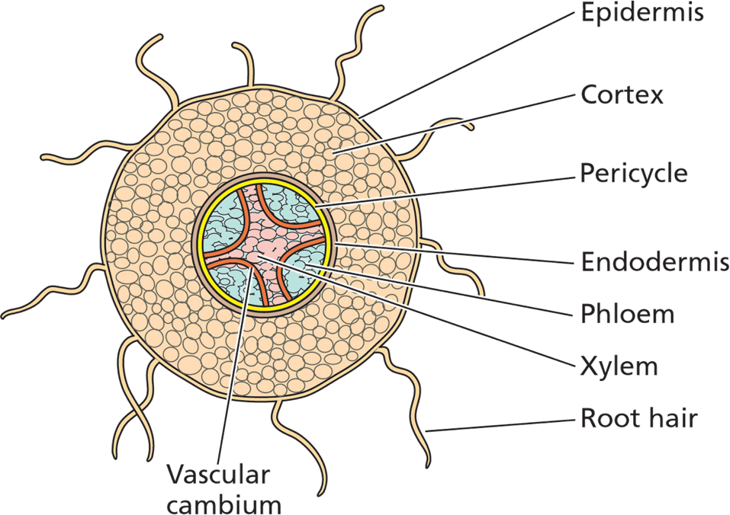
Root structure

Slide 10
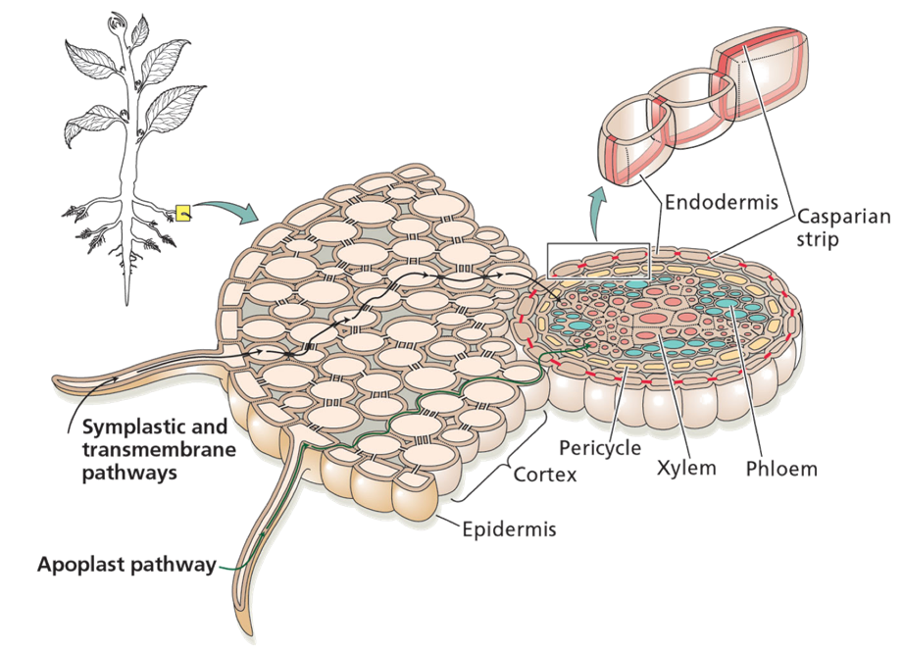
Root water conduction
Symplast / apoplast
Endodermis
Casparian strip

Slide 11
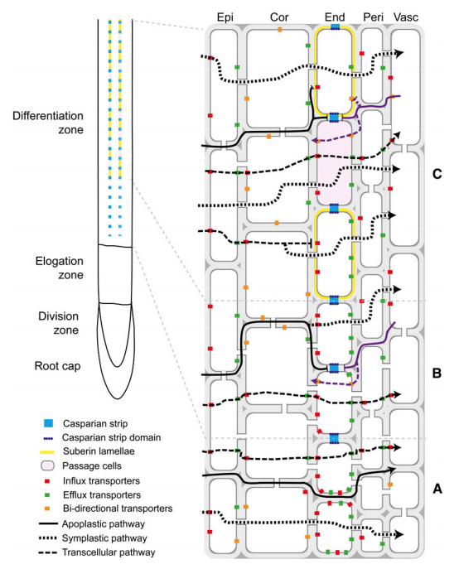
Root water conduction
Robbins et al., 2014

Slide 12
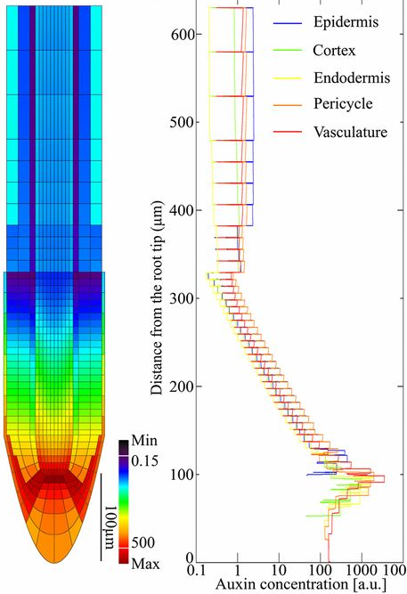
Growing tips
Di Mambro et al., 2017

Slide 13
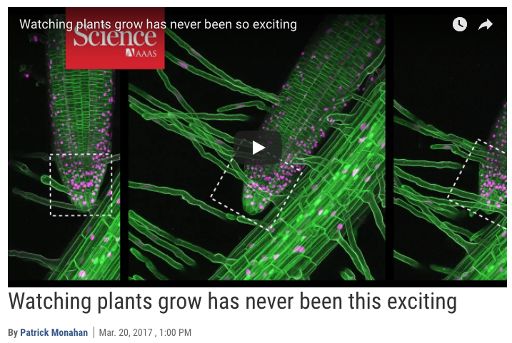
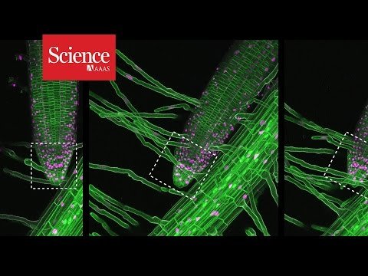
Roots down!

Slide 14
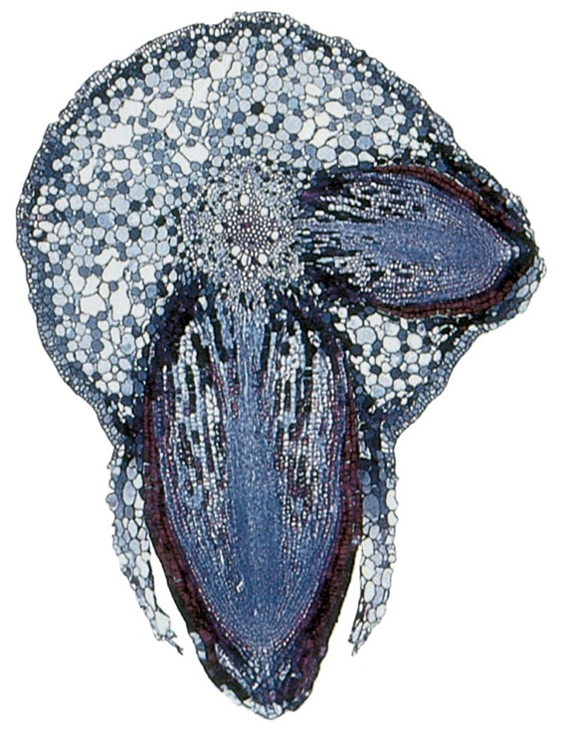
Origin of lateral roots
Erupt from within vascular cylinder (Why? How?)

Slide 15
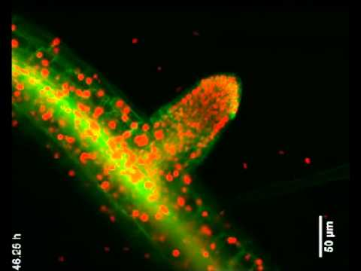

Slide 16
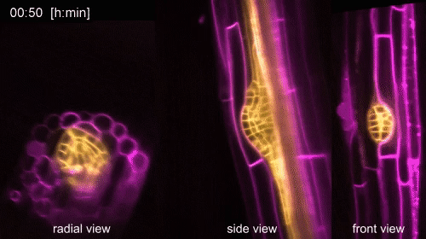

Slide 17
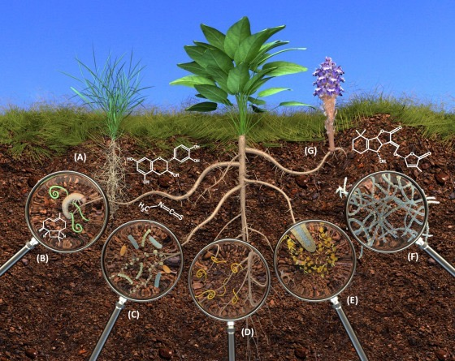
The rhizosphere
van Dam and Bouwmeester, 2016

Slide 18
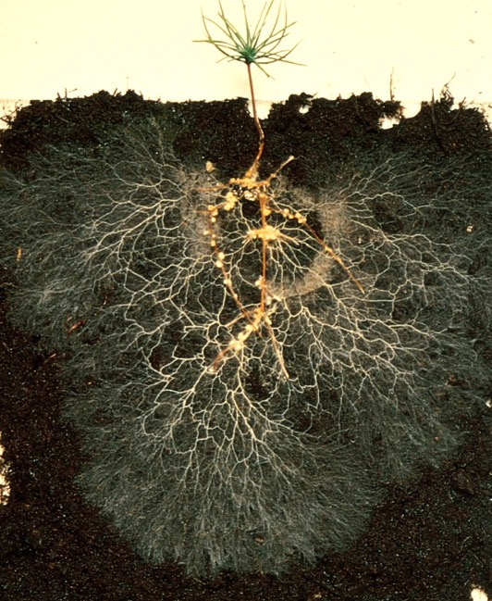
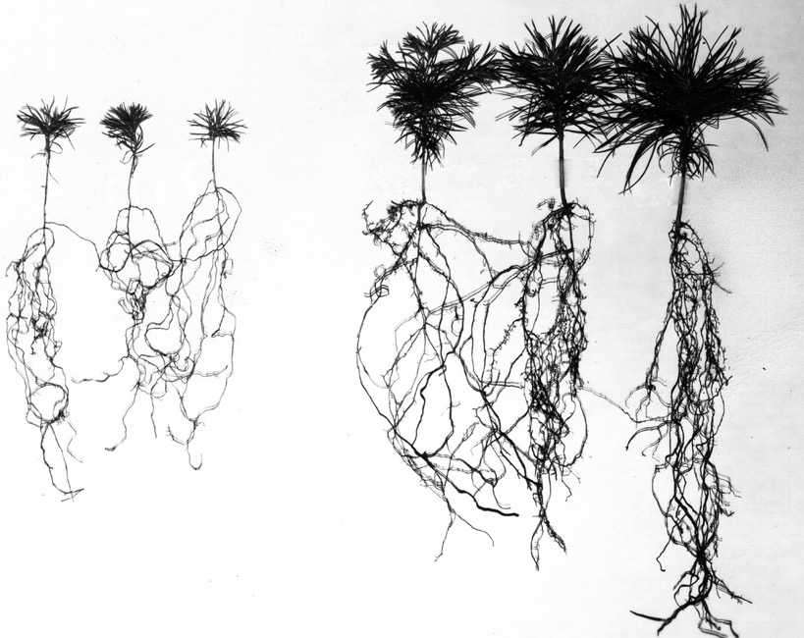
Mycorrhizae

Slide 19
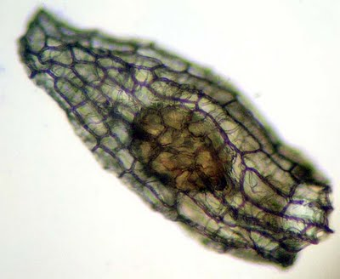
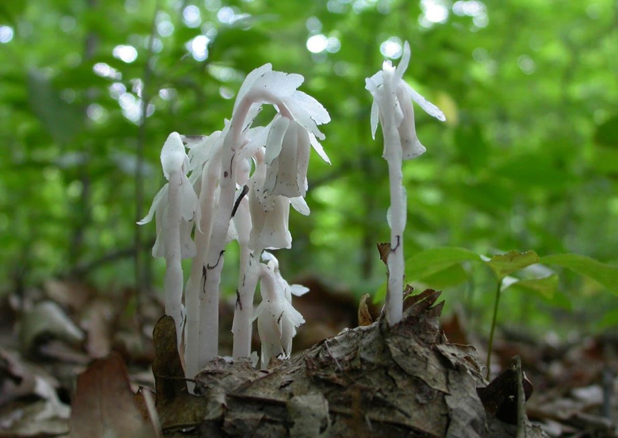
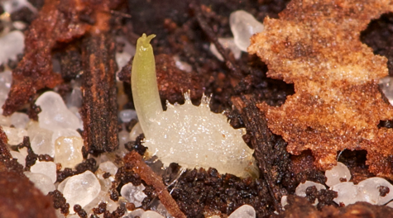
Helping hyphae
Orchid seed
Ghost pipe (Monotropa)

Slide 20
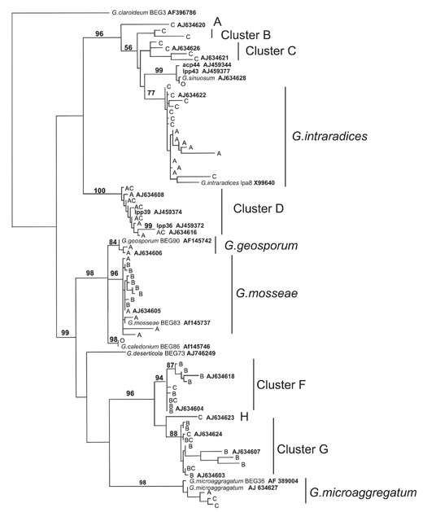
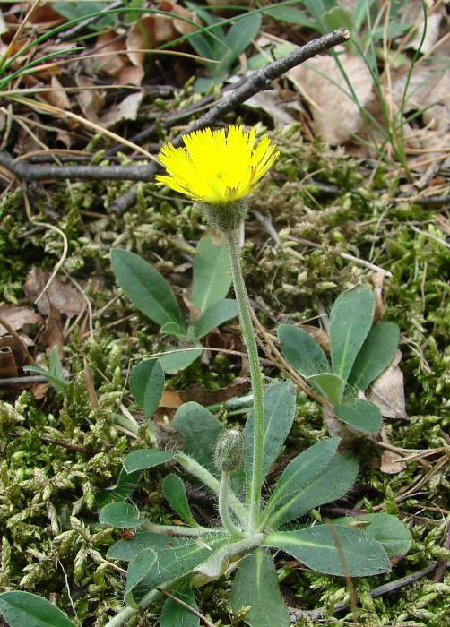
(Undisturbed) mycorrhizal community diversity
Rosendahl and Stuckenbrock, 2004

Slide 21
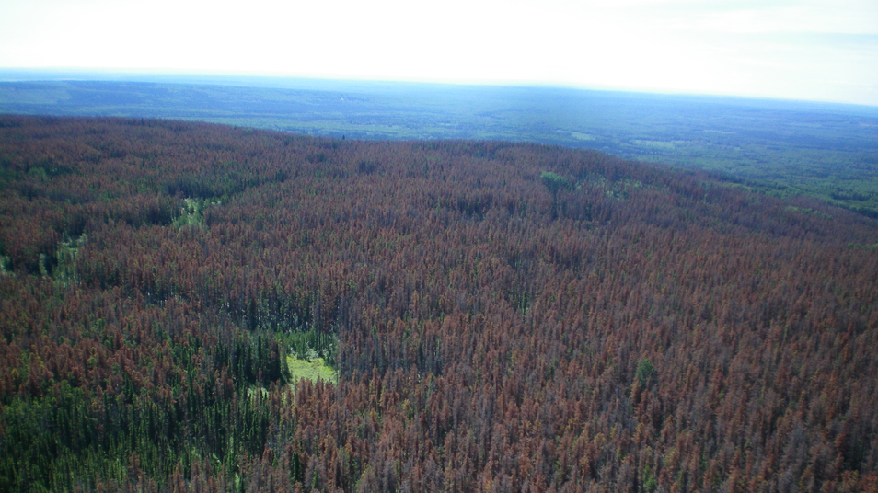
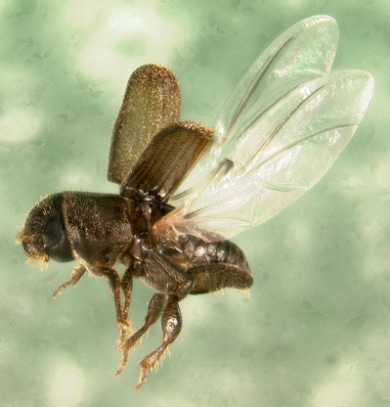
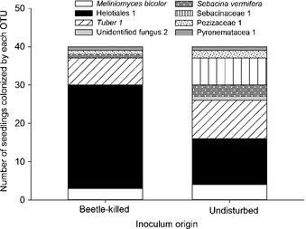
Mycorrhizal community interdependence
Karst et al., 2015

Slide 22
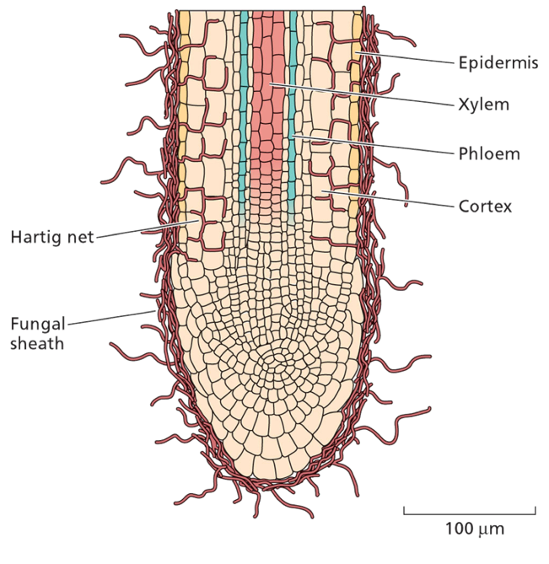
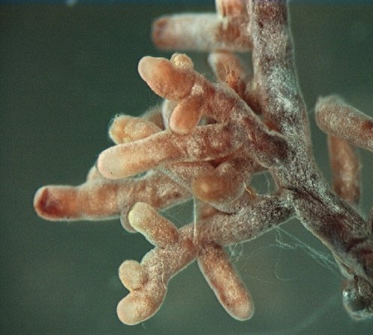
Ectomycorrhizae

Slide 23
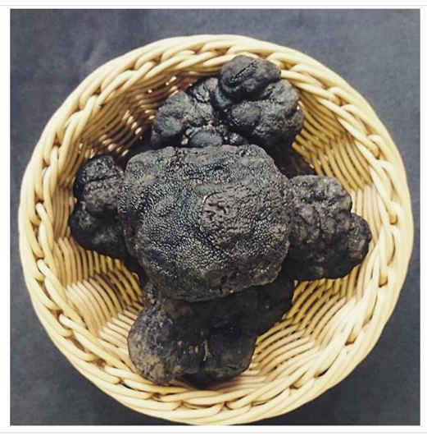
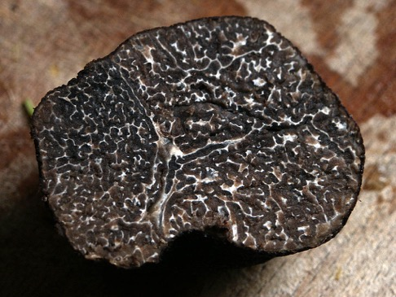
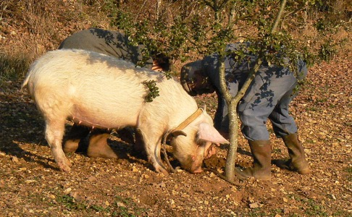

Truffles

Slide 24
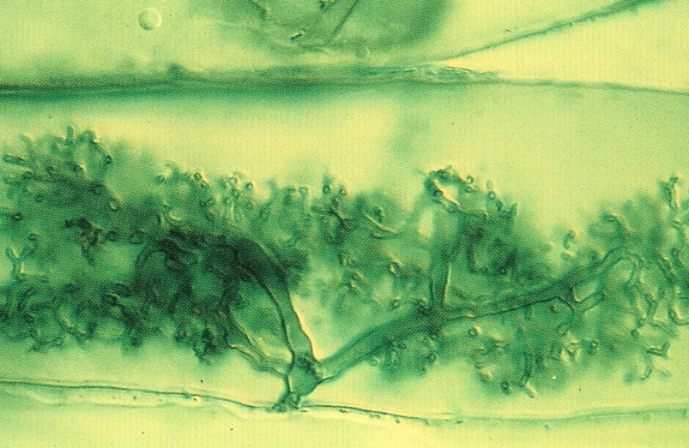
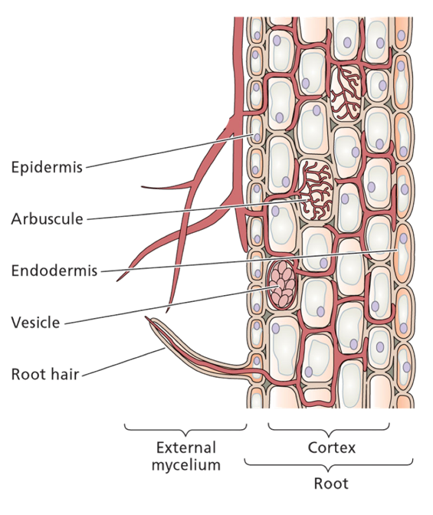
Endomycorrhizae
80% of plants have endomycorrhizal associates

Slide 25
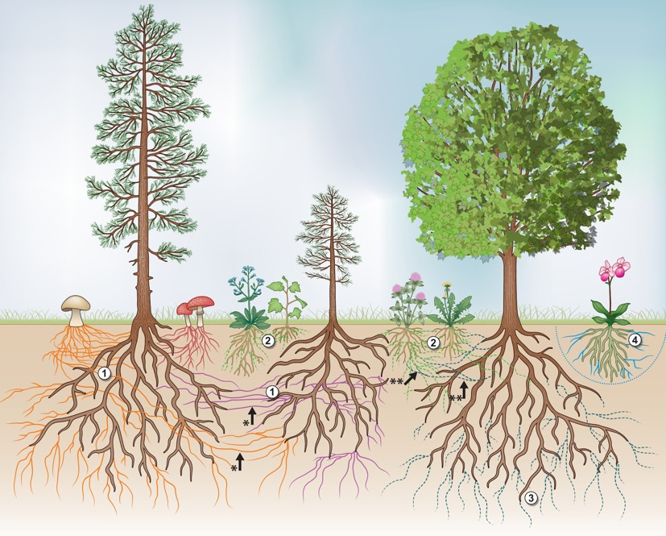
Mycorrhizal networks
van der Heijden et al., 2015

Slide 26
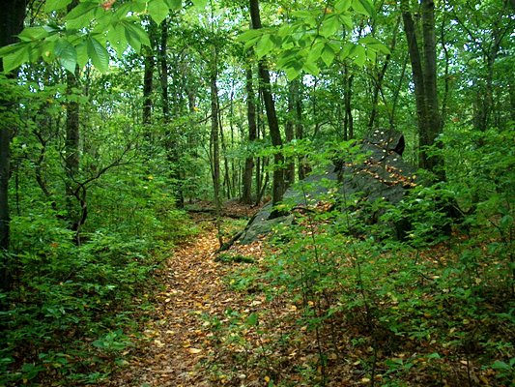
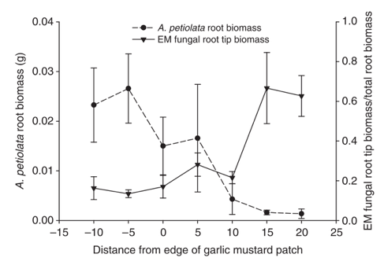
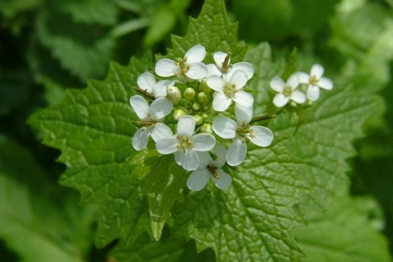
Poisoning the well
Wolfe et al. 2008

